Slide 1
Data modeling
DONE BY:
Vignesh saran T
vigneshvsinl123@gmail.com
8870272324

Slide 2
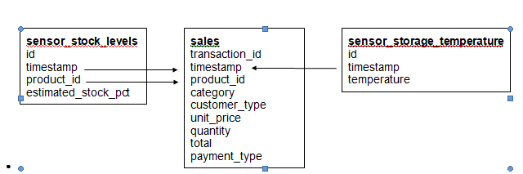
BLOCK DIAGRAM

Slide 3
This data model diagram shows:
● 3 tables:
○ sales = sales data
○ sensor_storage_temperature = IoT data from the temperature sensors in the storage facility for the products
○ sensor_stock_levels = estimated stock levels of products based on IoT sensors
● Relations between tables
○ These are shown by the arrows. Make note of the columns that connect the start and end of the arrows, this indicates how you can merge the tables using these linked columns.

Slide 4
transaction_id | timestamp | product_id | category | customer_type | unit_price | quantity | total | payment_type
a1c82654-c52c-45b3-8ce8-4c2a1efe63ed | 02-03-2022 09:51 | 3bc6c1ea-0198-46de-9ffd-514ae3338713 | fruit | gold | 3.99 | 2 | 7.98 | e-wallet
931ad550-09e8-4da6-beaa-8c9d17be9c60 | 06-03-2022 10:33 | ad81b46c-bf38-41cf-9b54-5fe7f5eba93e | fruit | standard | 3.99 | 1 | 3.99 | e-wallet
ae133534-6f61-4cd6-b6b8-d1c1d8d90aea | 04-03-2022 17:20 | 7c55cbd4-f306-4c04-a030-628cbe7867c1 | fruit | premium | 0.19 | 2 | 0.38 | e-wallet
157cebd9-aaf0-475d-8a11-7c8e0f5b76e4 | 02-03-2022 17:23 | 80da8348-1707-403f-8be7-9e6deeccc883 | fruit | gold | 0.19 | 4 | 0.76 | e-wallet
a81a6cd3-5e0c-44a2-826c-aea43e46c514 | 05-03-2022 14:32 | 7f5e86e6-f06f-45f6-bf44-27b095c9ad1d | fruit | basic | 4.49 | 2 | 8.98 | debit card

Slide 5
ANALYSIS
Here are the key findings from my analysis:
The dataset consists of sales data with various columns such as transaction ID, product ID, date of sale, category, customer type, unit price, quantity, total, and payment type.
The dataset includes sales data for a specific period, from [2022-03-01] to [2022-03-07].
The average price of products sold is $7.79, with a minimum price of $0.19 and a maximum price of $23.99.
The apple sold in large quantities, while the pet sold in small quantities.
Kitchen products are the top revenue-generating category.Spices and herbs are the lowest revenue-generating categories. This category is taken by the total revenue of sales.

Slide 6
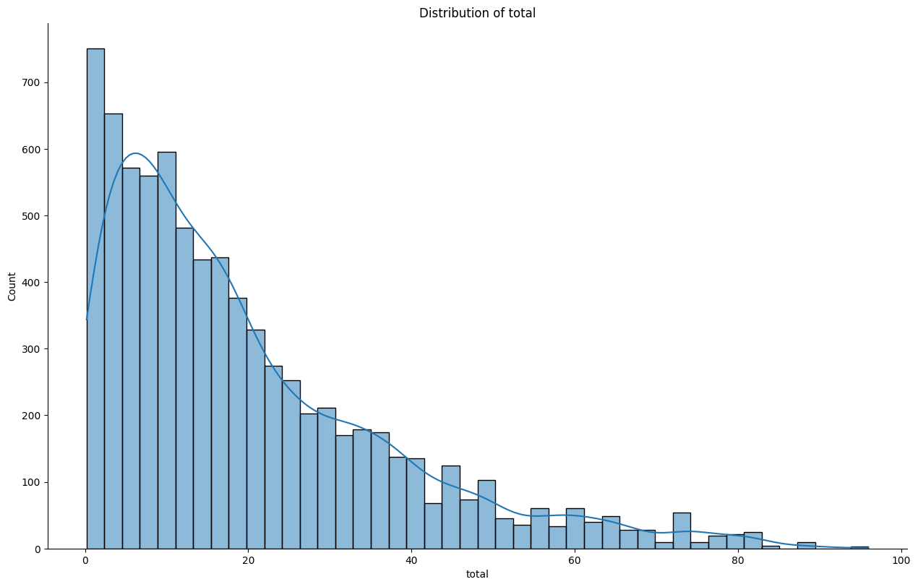
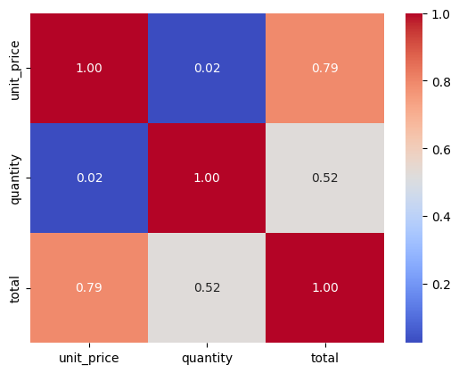
GRAPHICAL REPRESENTATION

Slide 7
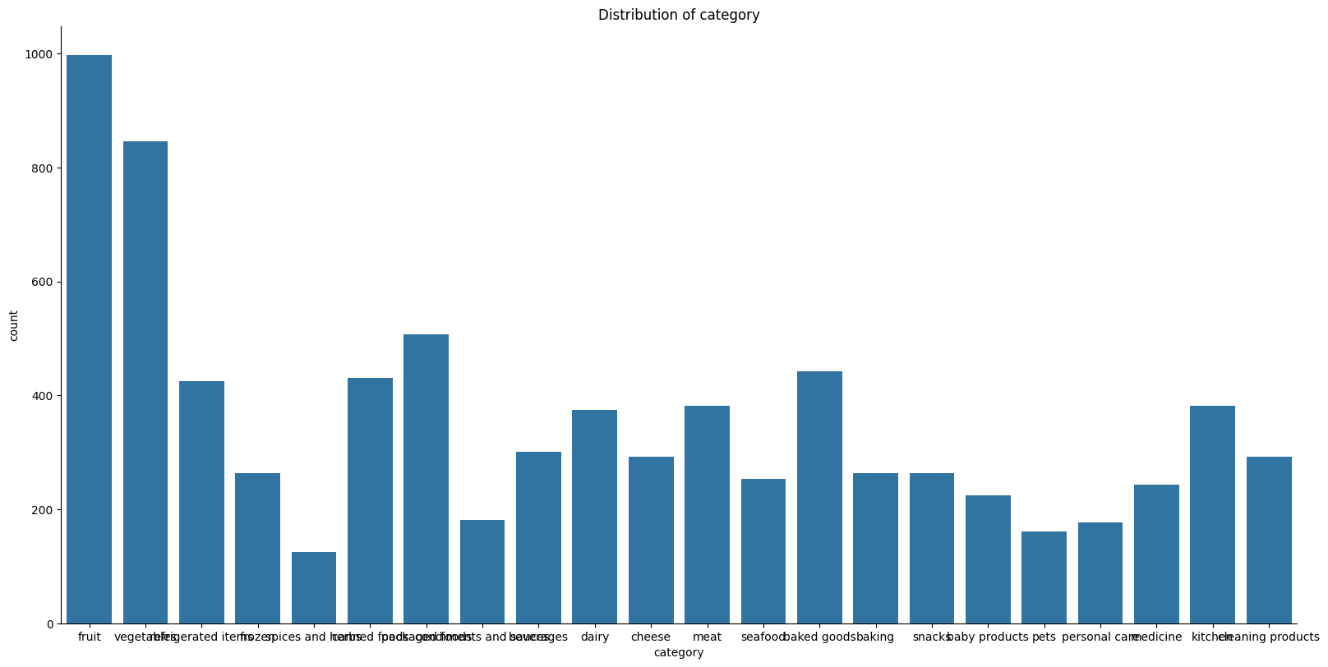

Slide 8
THANK YOU

